Slide 1
AVO analysis & rock physics based AVO inversion
Stud. MSc Asger Johansen
Supervisors:
Thomas Mejer Hansen, IMM DTU
Ida Lykke Fabricius, BYG DTU
Notes:
The topic of the thesis is AVO analysis and AVO inversion.
The basic principle of an AVO analysis is to interpret the geological cause of the observed amplitude variation
The basic principle of the AVO inversion is to predict the model properties causing a certain response.
AVO is an abbreviation of Amplitude variation with offset and describes how the recorded seismic response varies as a result of the properties of the subsurface and the angle of the incident wave.

Slide 2
Presenting
Objectives of the thesis
Part I-III
  Method
  Results
  Conclusions
Thesis: Discussion
Thesis: Conclusion

Slide 3
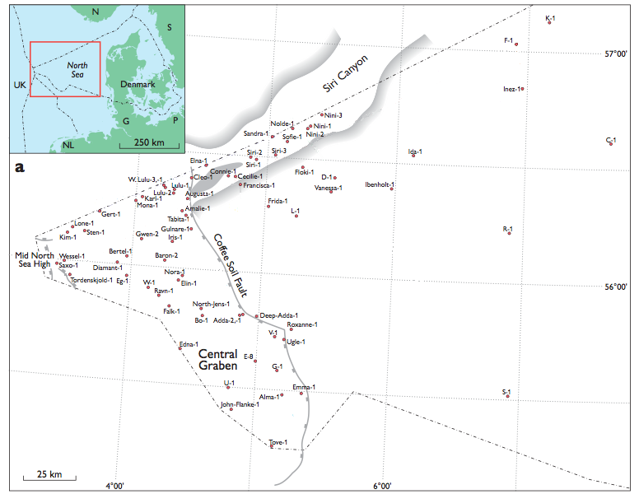
Nini-1
Area of seismic data
(picture: Schiøler et. al)
Notes:
The field studied is the Nini field in the Danish part of the North Sea
Both well log data, laboratory data and seismic data are available.
The reservoir rock is greensand which is known to be located in the Hermod formation and the Ty formation. Only greensand from the Hermod formation is investigated in this study.
The work of this thesis is divided into three objectives

Slide 4
Objectives
AVO response
Investigate and assess the AVO response of North Sea oil and brine saturated greensand from the Hermod formation
AVO analysis
Investigate the possibility of identifying oil reservoirs from seismic data
AVO inversion
Investigate the prospects of predicting the physical properties of greensand from seismic data by a rock physics based non-linear AVO waveform inversion

Slide 5
Workflow
AVO response
Prospects of inverting seismic data
AVO
analysis
Where to invert
AVO inversion
Predicting physical properties
Notes:
The relation between these three objective are illustrated at this figure
Initially, the prospects of inverting physical properties of greensand is investigated by assessing the AVO response of greensand. That is, if the AVO response of for example oil and brine saturated greensand were alike, it would not be feasible to invert the oil saturation from the AVO response.
Next, it is crucial to known which seismic data to invert. The reason to this is that the algorithm is not fast enough to be applied to the entire cube of seismic data.
Finally the AVO inversion is performed justified by the results of the previous two parts.

Slide 6
Part I:
AVO response of greensand
Forward model the AVO response
Estimate elastic properties
  Oil and brine sat. greensand
  Of an upper and lower reflecting layer
Observe the AVO response from seismic data
Notes:
The AVO response is initially forward modelled in terms of p-wave reflection coefficients
In order to due so, the elastic properties of the greensand and of the layer above needs to be estimated
This is performed from both well log data, laboratory data and elastic properties forward calculated from the rock physics model incorporated in the AVO inversion.
In addition to this the AVO response is observed from the seismic data
The relation between the AVO response, the p-wave reflection coefficients and the seismic traces is illustrated by the following figure

Slide 7
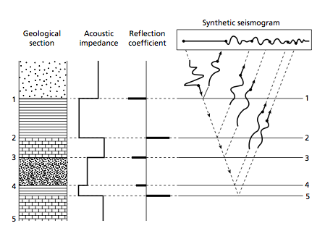
AVO
(Amplitude variation with offset)
(picture: Kearey, P. (2002)
Notes:
The emitted seismic wave of a seismic survey, travels down through the subsurface and reflects whenever it hits an interface across which the elastic properties changes.
The amplitude of the reflection is described by the reflection coefficients of the reflecting interfaces which is determined by the elastic properties across the reflector and the angle of the incident wave.
The elastic properties of the greensand and the layer above and below, in order to model the top and bottom reflectors, are initially estimated by the well log data. At first the greensand layers are identified illustrated by this next slide.

Slide 8
Identified greensand
(Oil saturated)
Notes:
The greensand identified from this well log, the Nini-4 well, is seen to be oil saturated by the high resistivity due to the low conductivity of the oil.
The greensand layer is shown by the green background color. The depth interval of which the elastic properties of the layer above is shown by a pink background color.
The elastic properties are estimated by an average.
The reflectivity is then calculated as seen by the next slide.

Slide 9
Notes:
The reflectivity is calculated by the exact derivation of the Zoeppritz equation and by the linear two-term Shuey approximation
First of all it is seen that AVO response of brine and oil saturated greensand is different.
The p-wave reflection coefficients are not seen to change as function of offset, being the angle of the incident wave, in contrast to the reflectivity of the oil saturated greensand.
The reason to this is the low poisson ratio / vp-to-vs ratio of the oil saturated greensand
The performance of the Shuey approximation is found to approximate the reflectivity well especially to the oil saturated case.
In order to compare this response to the seismic data, the greensand is identified at the seismic profiles.

Slide 10
Greensand
Balder
Ekofisk
Notes:
This is performed by calculating the two-way travel time of the well log measurements and identifying the same response of the seismic data.
The location of the Hermod greensand layer between the Balder and Ekofisk formation identified from the well logs are shown at this figure

Slide 11
AVO response
Observed from the seismic data at the Nini-1a well location
Notes:
The predicted response forward calculated by the p-wave reflection coefficients is confirmed by that observed from seismic data
Enclosed by the circle you see the top and bottom reflector from the seismic data at the location of the Nini-1a well where the greensand is known to be oil saturated
This response is also shown by a movie of the different angle gathers presented by this next slide

Slide 12
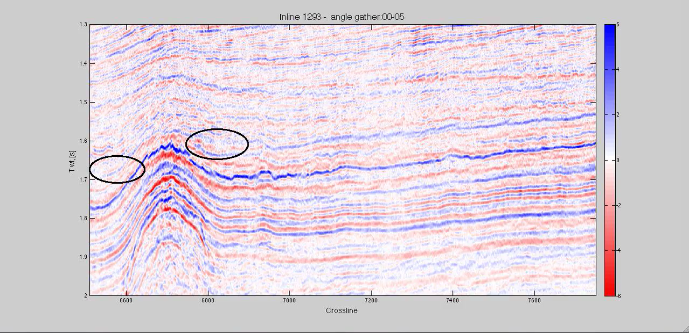
AVO response
From seismic data
Notes:
The amplitude variation with offset is shown by this video of the different angle gathers of the pre-stack seismic data.
The two circles encloses the greensand of the Nini-4 and Nini-1a well known to be oil saturated. At longer offsets the amplitude of the top and bottom reflectors are seen to increase

Slide 13
Conclusion - Part I:
AVO response of oil sat. greensand
AVO response of oil sat. greensand different from brine sat. greensand
Oil saturated characterized by:
  a top reflector which amplitude increases negatively with offset
  A bottom reflector which amplitude increases positively with offset
Notes:
In the geological setting of the Nini field, Greensand is found to have a top reflector with an increase negative amplitude and a bottom reflector by an increase positive amplitude
The prospects of identifying possible oil reservoirs from the seismic data and inverting physical properties by AVO inversion is justified by the fact that the AVO response of oil saturated greensand is different from the brine saturated

Slide 14
Part II: Identifying possible oil reservoirs
Method of identifying the seismic attribute of oil
Visualize the possible oil reservoirs
Notes:
This part concerns the prospects of identifying possible oil reservoirs throughout the area of the seismic data
This is performed by an AVO analysis based on the assessed AVO response of the oil saturated greensand.
The method involves deconvolution of the seismic data in order to obtained the deconvolved reflection series. The reflectivity is then described by a linear function. The gain of this is to detect the hydrocarbon indicator by only two coeffcients. The principle of this is illustrated by the next figure.

Slide 15
A
A
B (slope) ≈ 0
B (slope)= big negative
Notes:
The two-term approximation of shuey is linear with respect to the sinus of the angle of incidence squared.
The intercept coefficient is denoted A while the gradient of the linear function is denoted B.
This slope is related to the ratio of p-wave to s-wave velocity or poisson ratio across the reflector. When oil saturated the poisson ratio or the ratio of p-wave to s-wave velocity of greensand is low. The reason to this is the decrease in density which results in a increase in s-wave velocity.
These two coefficients are in often depicted by A,B crossplot as shown by this next slide

Slide 16
Oil sat.
Brine sat.
Notes:
The basic principle of identifying possible oil reservoirs from seismic data is illustrated by this figure.
This figure is depicting the A and B coefficients calculated from the well log measurements of the Nini-4 well. The A and B coefficients are calculated by every log measurements of the target rock with an average elastic properties of the reflecting layer above.
The big negative slope of the forward calculated p-wave reflection series in terms of the high negative B coefficients are seen at the figure. The trend of the A and B coefficients of the brine saturated greensand is referred to as the fluid line.
As a result the oil saturated greensand is displaced to the left of the brine saturated greensand. This is the typical indicator of hydrocarbons as the brine saturated rocks are assumed to be located close to the fluid line.
So, the method of identifying possible oil reservoirs from seismic data is based on describing the deconvolved reflection series and identifying the indicator of hydrocarbons by the location of the estimated A and B coefficients from the linear regression to the deconvolved reflection series in the crossplot
As the greensand is known to be located between the Ekofisk and Balder formation, an abnormal trend of the A and B coeffficients are only searched for between these two layers.

Slide 17
Greensand
Balder
Ekofisk
Notes:
The location of the Hermod greensand layer between the Balder and Ekofisk formation identified from the well logs are shown at this figure
As the method of identifying the possible oil reservoirs is automated to inspect the seismic data throughout the area of the seismic data, these two layers are assessed.
This is performed by inspecting seismic profiles and by a 2-dimensional interpolation.

Slide 18
Notes:
Initially the candidates of expressing a possible seismic anomaly are identified by a definition on the A,B location in the crossplot as shown by this next slide

Slide 19
Oil sat.
Brine sat.
Notes:
The locations where the A,B coefficients are located in the lower left corner is shown by the following slide by the black dots on the top-subplot

Slide 20
Nini-1a location
Notes:
The numerical values of the coefficients are shown in the lower subplots. The coefficients at the location of the Nini-1a well are seen to be those most negative. This is related to he abnormality of the possible seismic anomalies. A measure of the abnormality is the distance to the fluid line shown at the next slide

Slide 21
Greatest distance
Notes:
Again the known oil reservoir of the Nini-1a location is seen by the largest distance to the fluid line.
Visualizing possible oil reservoirs throughout the area of seismic data is performed by calculating the A and B coefficients of several seismic profiles between the Ekofisk and Balder formation and calculating the distance to the fluid line. The possible oil reservoirs are then seen by depicting each possible seismic anomaly by its distance to the fluid line as fully transparent dots in a 3D scatterplot.

Slide 22
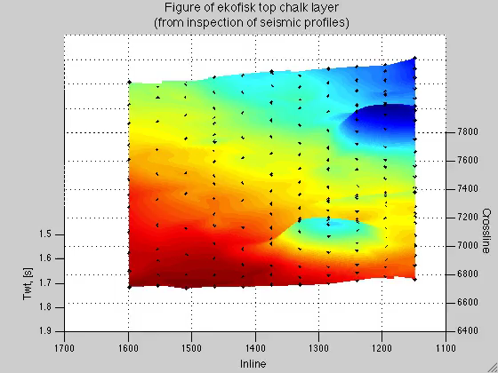
Ekofisk
Notes:
This requires the Ekofisk and Balder formation to be assessed throughout the area of seismic data as shown in a 3D view:
The 3D scatterplot of possible seismic anomalies are shown by the next slide

Slide 23
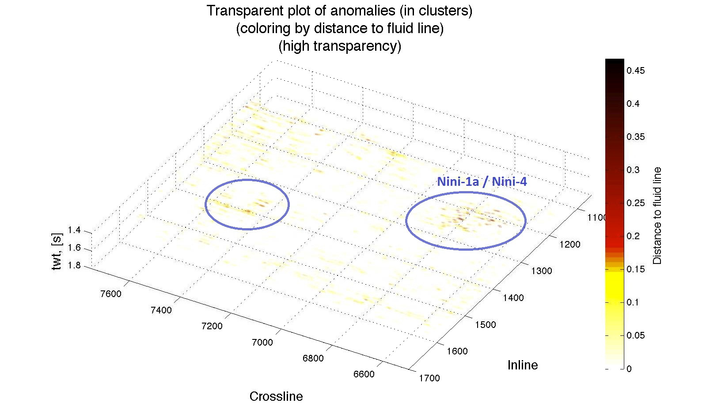
Notes:
This scatterplot method is not depicting the possible oil reservoirs that well but the oil reservoirs of the Nini-1a and Nini-4 wells are identified.
An alternative way to visualize the locations of most abnormal identified possible seismic anomalies is by a density plot of only those possible anomalies which have a distance to the fluid line above a certain value (similar to that found from the oil saturated greensand around the Nini-1a and Nini-4 well location).

Slide 24
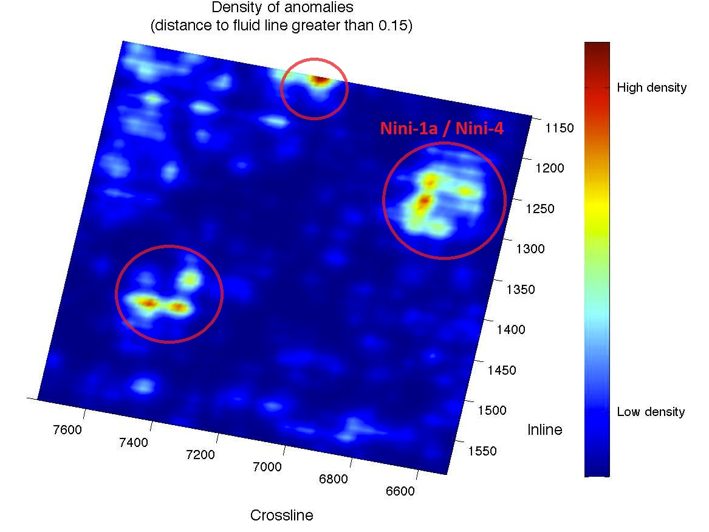
Notes:
Again the oil reservoir around the Nini-1a / Nini-4 well location is identified and also the other possible oil reservoirs seen before. At the SPE meeting in februar where I presented these results, this location was recognized as a known field which have been drilled. Inspecting the amplitude variation with offset at a seismic profile of this location, a very nice direct hydrocarbon indicator is observed.
Also a third possible oil reservoir isidentified by this method but as it is located at the edge of the seismic data its lateral extent is not assessed.

Slide 25
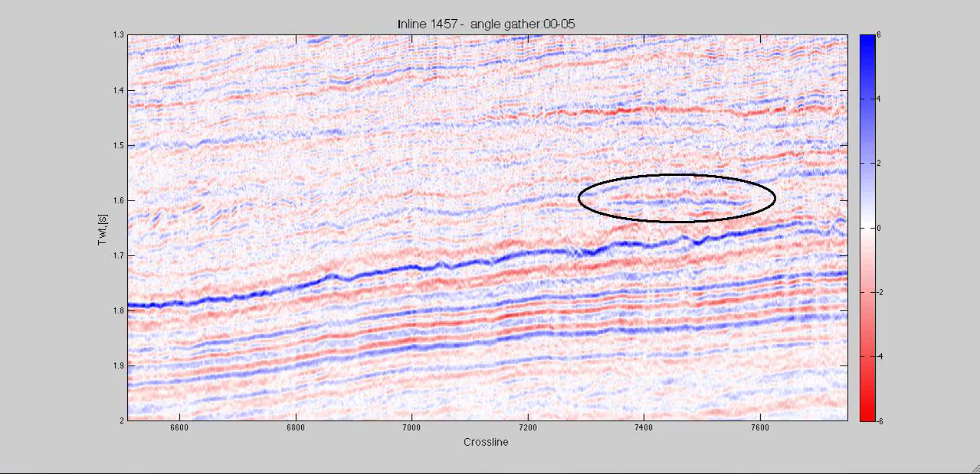
Notes:
Again the top reflector and bottom reflectors are seen by the same characteristics as that assessed from the oil saturated greensand.

Slide 26
Conclusions from part II
Method of identifying possible oil reservoirs verified
The oil reservoir around Nini-1a and Nini-4 identified
Another “known” oil reservoir identified
A third possible oil reservoir identified

Slide 27
Part III: AVO inversion
Predicting physical properties of greensand from seismic data
non-linear AVO waveform inversion
Metropolis inversion
Notes:
The basic principle of seismic inversion is to predict the properties of the subsurface from the seismic response observed.
The inversion performed is an AVO waveform inversion by constructing synthetic traces, simulating the seismic data.
The inversion method is the metropolis algorithm.
The model properties are by this stochastic inversion method are described as probability distributions.

Slide 28
Principle of the algorithm
  Iteratively
  Sampling a realization of the posterior distribution
Propose model
Forward model
Misfit to data
Accept / reject model
Notes:
The basic principle of inverting the model properties is by the iterative process of proposing models, forward calculating the forward response, evaluating the misfit to the seismic data and based on this accepting or rejecting the proposed model as a sample of a realization of the posterior distribution.

Slide 29
Forward model
Non-linear rock physics model
Non-linear reflectivity model
Convolution model
Notes:
The seismic data is simulated as a three-layer model
The objective of the forward model is to relate the model properties to the synthetic traces
The objective of the rock physics model is to transform a model of physical properties of greensand, by for example the porosity, to elastic properties in terms of p-wave, s-wave velocity and density
As the inversion method allows a non-linear forward model, the reflectivity is calculated by the exact solution of the zoeppritz

Slide 30
The rock physics model
Hertz-Mindlin grain contact model
  Modelling: K_{dry} and μ
  Estimating:
    Poisson ratio
    Glauconite bulk and shear moduli
Gassmann fluid substitution
  Estimating:
    Mineral modulus
Notes:
The rock physics model incorporated is that of Hertz-Mindlin and Gassmann. The Hertz-Mindlin is modelling greensand as proposed by Hossain. Hertz-Mindlin is a grain-contact model modelling the dry bulk modulus and the shear modulus by interaction of the glauconite and quartz grains.
Modelling greensand involves estimating the poisson ratio of the greensand and the glauconite bulk and shear modulus as the glauconite grain is known to be micro-porous
The saturated bulk modulus is obtained by use of the Gassmann fluid substitution which involves estimating the mineral modulus.
The principle of forward modelling the synthetic traces through the rock physics model is illustrated by the following movie.

Slide 31
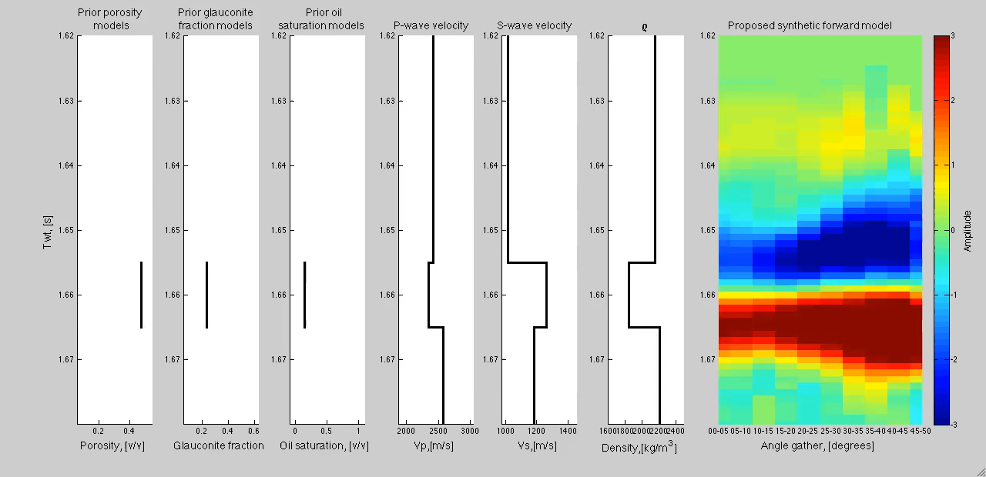
Illustrate forward model
Notes:
To the right you see the forward calculated traces from a model of the porosity, oil saturation and glauconite fraction.
The principle of sampling the posterior distribution is illustrated by the next movie.

Slide 32
Sampling a posterior distribution
Accept model by:
  Likelihood of a proposed model
  Accept:
    If: L(m_propose) >= L(m_current)
    Else if: L(m_proposed) / L(m_current) > rand([0:1])
  m_current = m_propose
Measure of how well the accepted models fits data relative to each other
  Number of iterations between accepted models
Notes:
The likelihood of a proposed model describes how well a proposed model fits the seismic data

Slide 33
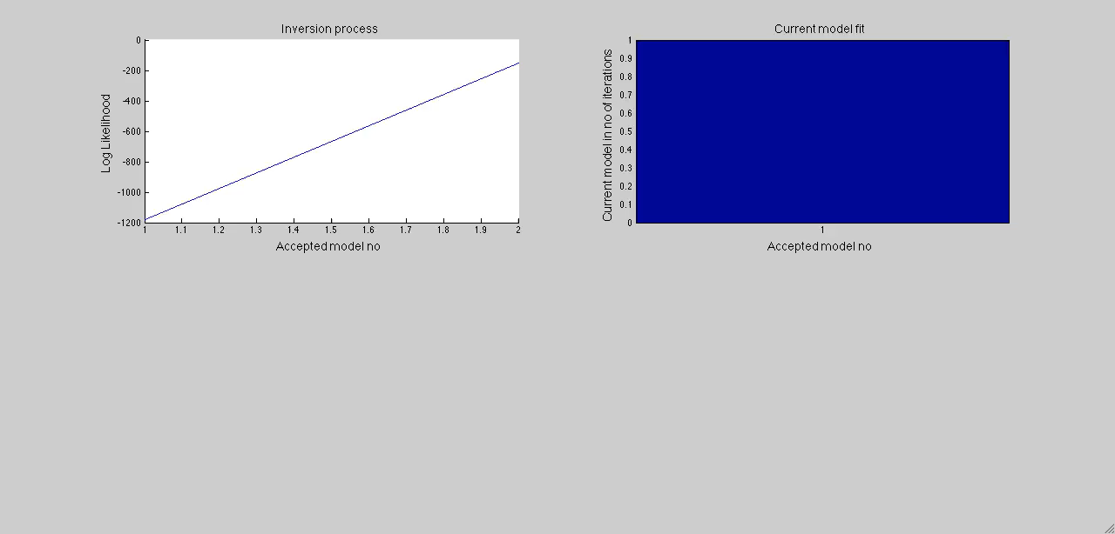
Illustrate sampling method
Notes:
The inversion method of the metropolis algorithm is searching the model space according to a random walk. The random walk has a memory of a current model. Which means that the models are accepted by two criteria. The method of sampling the posterior distribution is described by this movie.

Slide 34
Synthetic reference model
  Different prior scenarios
The waveform inversion requires the elastic properties of the 1. and / or 3. layer to be known
Inversion using the Hertz-Mindlin rock physics model is found to require the P_{eff}, C and φ_{glauconite} to be known
Notes:
Initially, the performance of the rock physics based inversion is investigated by a synthetic reference model under different prior scenarios.
The waveform inversion is found to require the elastic properties of the 1. and / or 3. layers to be known. The reason to this is that the reflectivity primarily depends on the relative contrast in elastic properties across a reflecting interface
Also the rock physics model is found to require the effective pressure, glauconite micro-porosity and preferable also the coordination number to be known, due to the complexity of the rock physics model
Inverting seismic data is due to this initially performed by assuming these properties to be known. A comparison of the forward calculated traces by the known physical properties of the greensand is compared to the seismic data at the following slide

Slide 35
Inverting seismic data
Φ = 0.25
Φ_{glau} = 0.4
F_{glau} = 0.3
C=15
P_{eff} = 22 MPa
Oil sat = 0.9
Notes:
The synthetic traces are constructed from the elastic properties above and below the greensand estimated by from the well log, together with the elastic properties modelled using the rock physics model by the known properties of greensand.
The inversion run, inverting seismic data, involves as described a iterative process of proposing different models. The models proposed are given by the prior distribution seen at the next slide

Slide 36
Prior distribution
Notes:
The model properties of the porosity, glauconite fraction and oil saturation are seen to be uniform distributed.
However due to the rock physic model, the prior distribution of the elastic properties of greensand are not uniform.

Slide 37
Notes:
A little movie showing the models accepted is seen at the following slide

Slide 38
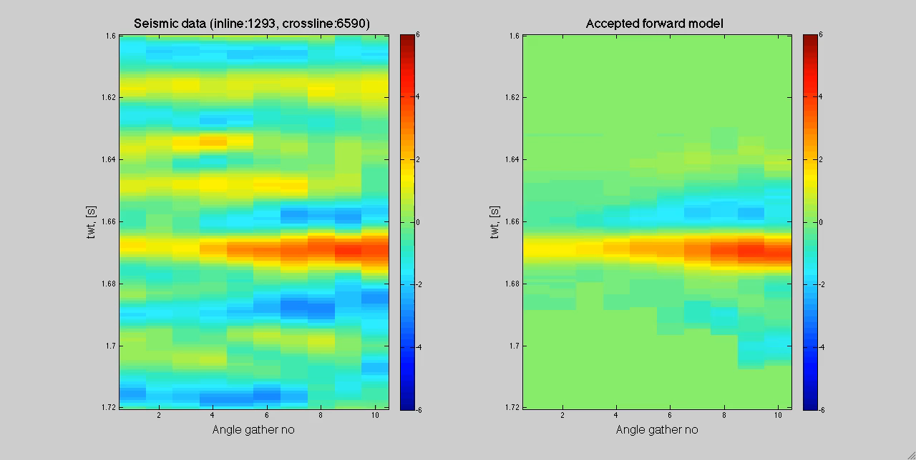

Slide 39
Notes:
As seen the physical properties of greensand are seen to be very well resolved / predicted from the posterior distribution.

Slide 40
Probabilistic estimates on:
Porosity
Glauconite fraction
Oil saturation
Notes:
As a benefit of the inversion method probabilistic estimates of the modeling properties are obtained.
Porosity: With 90 % certainty it is between 22-28 %
Glauconite fraction: with 90 % certainty is between 20-27 %
Oil : with 90 % certainty between 75-97%

Slide 41
Modeling greensand
Estimating the:
    Mineral modulus
    Poisson ratio
    Glauconite bulk and shear moduli
Investigating these estimates by inversion of seismic data
The estimates proposed by Zakir Hossain are verified from seismic data
Notes:
In addition to the gain of obtaining probabilistic estimates on the model properties the inversion method also offers to include additional modelling properties as sampling variables.
This is made use of by including the mineral modulus, the poisson ratio and the glauconite bulk and shear moduli.
Duing this it is investigated whether the proposed greensand elastic properties of greensand by Zakir Hossain are verified from seismic data.
The rock physics model used is the Hertz-Mindlin grain contact model combined with Gassmann for fluid substitution. Modelling greensand by this rock physics model is performed as presented by Zakir Hossain.
The micro-porous glauconite grain is assumed to be fully brine saturated.
Modelling greensand involves estimating a mineral modulus, a poisson ratio and a estimate of the bulk and shear modulus of the micro-porous glauconite grain. According to the estimated proposed by the paper of Hossain, the mineral modulus and poisson ratio is performed by a Voigt-Reuss-Hill average while the bulk and shear modulus of the micro-porous glauconite grain is estimated by the upper Hashin-Shtrikman bound.
The inversion is then performed without these estimates which mean that the mineral modulus and poisson ratio is proposed randomly between the Voigt-Reuss bounds and the bulk and shear glauconite moduli are proposed randomly between the upper and lower Hashin-Shtrikman bounds.

Slide 42
Inverting seismic data – Nini-1a
A discrepancy
observed
  Seismic data
  Forward model
  Elastic properties
  above the
  greensand
  Inversion by
  a 3-layer model
Notes:
While inversion of seismic data at the Nini-4 well location is seen to perform well… a problem is encountered when inverting seismic data from the Nini-1a well location.
Forward calculating the synthetic traces using the elastic properties above and below the modelled greensand from the well log measurements, an discrepancy is observed to the AVO response observed from the seismic data.

Slide 43
Conclusion part III
Feasible to invert the physical properties of greensand from seismic data
Requires prior information on both the greensand and the elastic properties above and/ or below
Challenge describing the seismic data by a 3-layer model
Notes:
Initial idea: To invert seismic data from the locations identified in part II where information from a well log is not available. This is not possible to to this discrepancy.
Challenge of inverting both the glauconite micro-porosity together with the glauconite fraction

Slide 44
Discussion Thesis:
The assessed AVO response depends on the geological setting
The method of identifying possible oil reservoirs only indicates a possible seismic anomaly
Challenge of inverting seismic data at locations without information from a well log
Describing the seismic data by a 3-layer model

Slide 45
Conclusion Thesis:
The results of part I supported:
  the possibility of identifying possible oil reservoirs from seismic data by AVO analysis
  An the possibility of inverting physical properties of greensand by AVO inversion
Two possible oil reservoirs identified
Inversion of physical properties are feasible however a challenge is encountered

Slide 46
Conclusion Thesis:
Elastic properties and the physical properties of greensand are required to be known
Inverting the physical properties at the two “unknown” possible reservoirs was not possible

